Slide 1
Capstone Project
Cardiovascular Risk Prediction

Slide 2
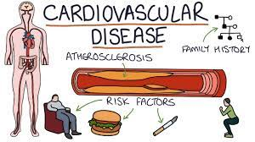
Problem Statement:
The dataset is from an ongoing cardiovascular study on residents of the town of Framingham, Massachusetts. The classification goal is to predict whether the patient has a 10-year risk of future coronary heart disease (CHD). The dataset provides the patients’ information. It includes over 4,000 records and 15 attributes.

Slide 3


Key Steps:
Defining the problem statement
Data Cleaning
EDA and data visualization
Data preprocessing
Feature selection
Preparing Dataset for model
Applying model
Model validation and selection

Slide 4
Why is predictive analytics useful for Cardiovascular risk ?
To know which patients are in risk:
To know which disease lead to Cardiovascular risk:
To know what habit lead to Cardiovascular risk:
To know what should be BMI, BP, Diabetes and Cholesterol level:

Slide 5
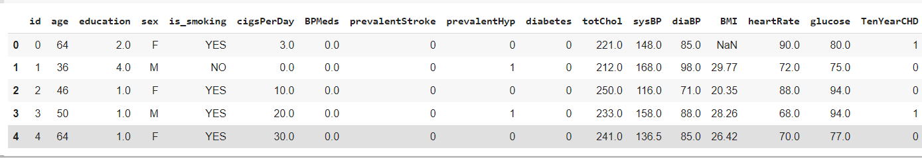
Dataset:
Rows : 3390
Columns : 17

Slide 6
Variable Names:
Sex:
Age:
is_smoking:
Cigs Per Day:
BP Meds:
Prevalent Stroke:
Prevalent Hyp:
Diabetes:
Tot Chol:
Sys BP:
Dia BP:
BMI:
Heart Rate:
Glucose:
10-year risk:

Slide 7

Exploratory Data Analysis:
EDA is used for analyzing what the data can tell us before the modeling or by applying any set of instructions/code.

Slide 8
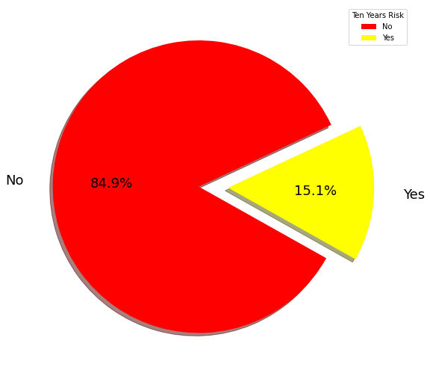
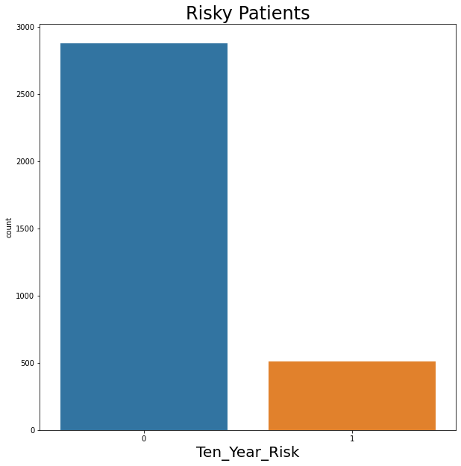
Risky Patients:

Slide 9
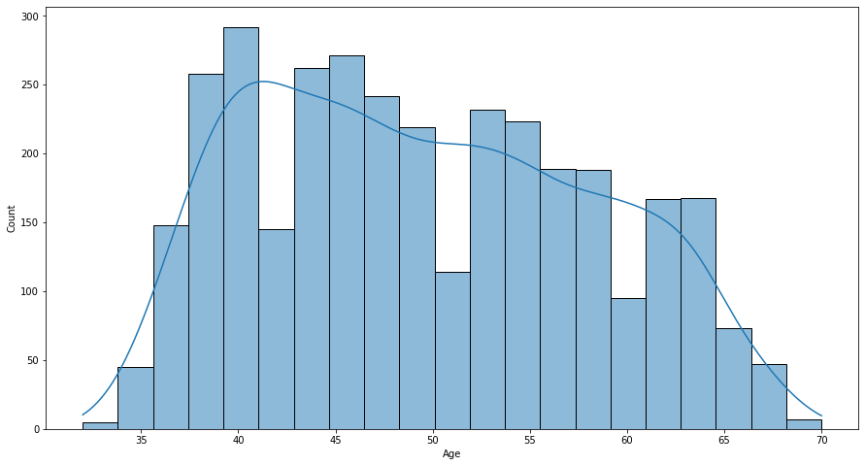
Distribution of age:

Slide 10
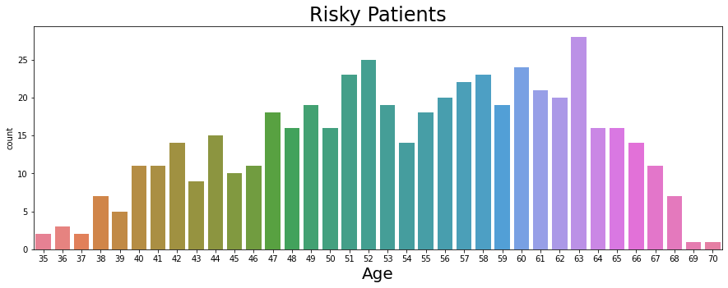
Risky Patients With Respect To Age:

Slide 11
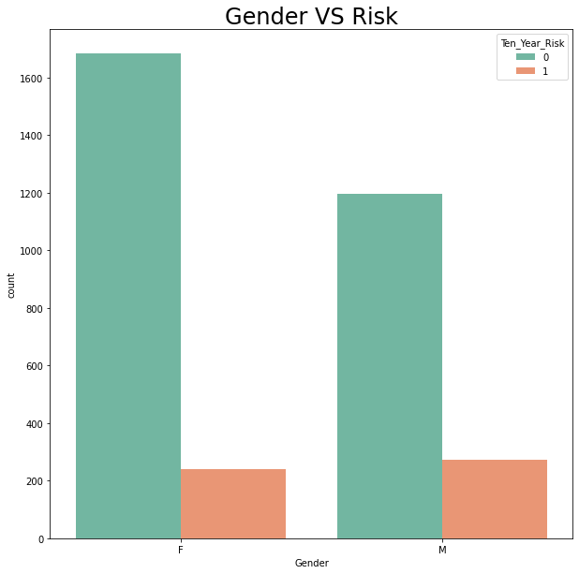
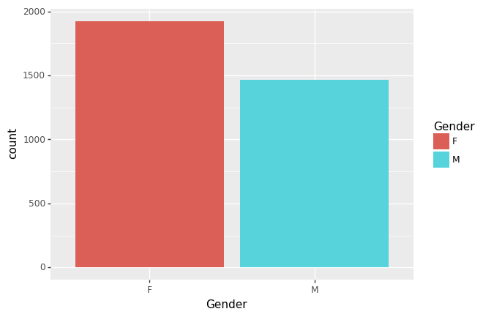
Risk with respect to gender:

Slide 12
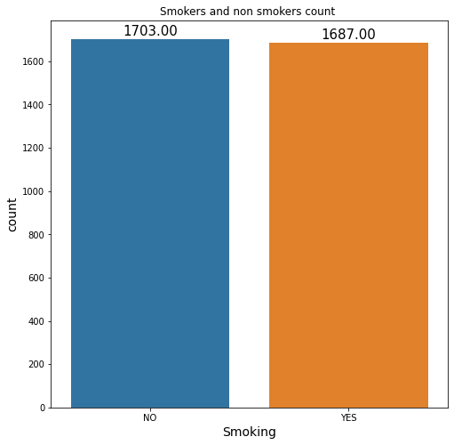
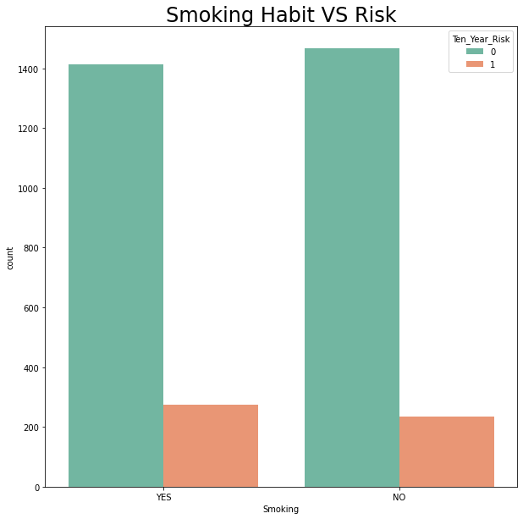
Risk With Respect To Smoking Habit:

Slide 13
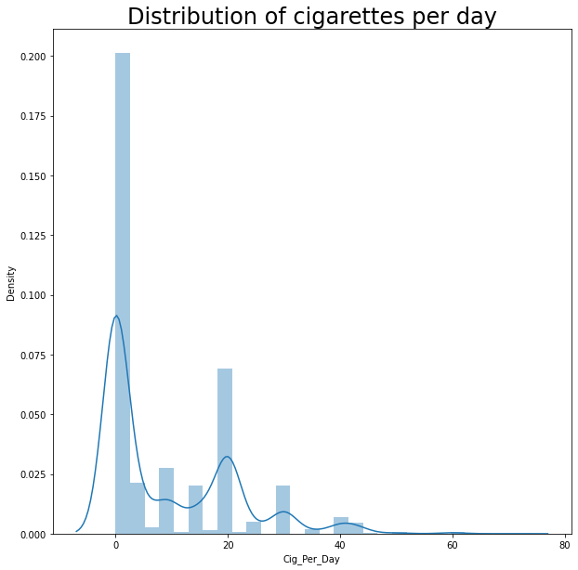
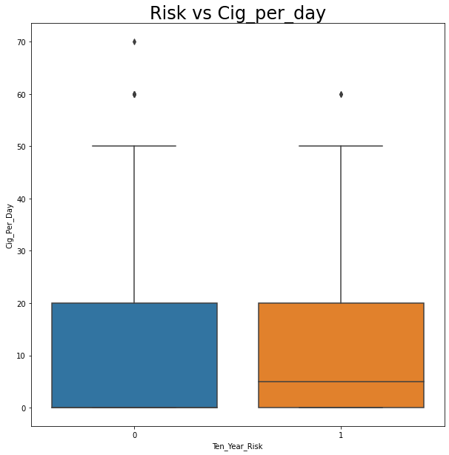
Risk With Respect To Cigarettes Per Day:

Slide 14
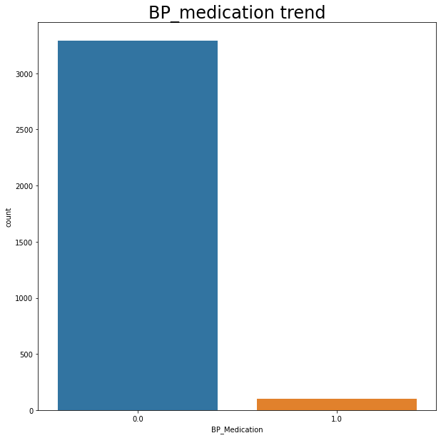
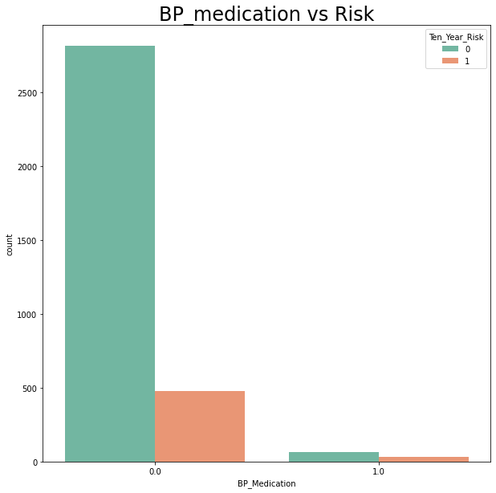
Risk With Respect To BP Medication:

Slide 15
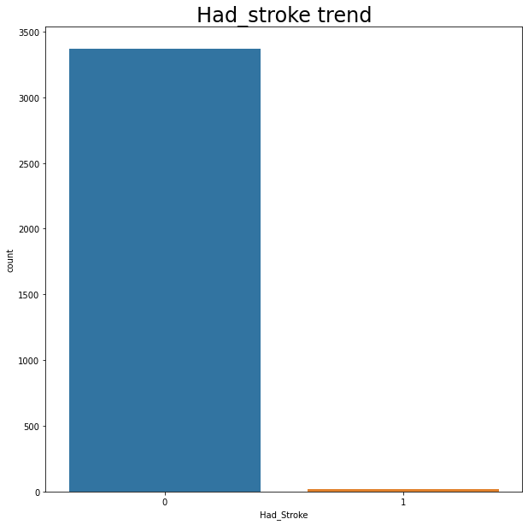
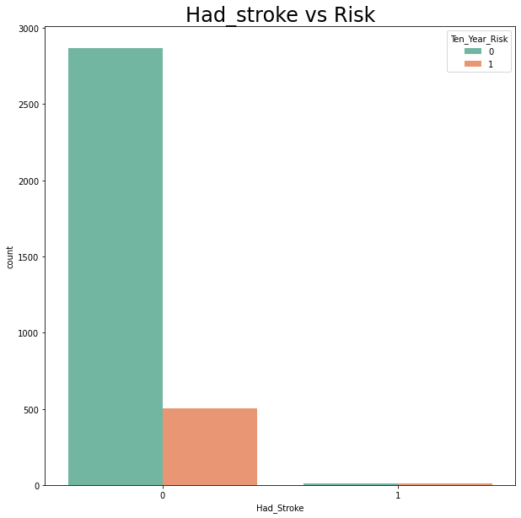
Risk With Respect To Stroke:

Slide 16
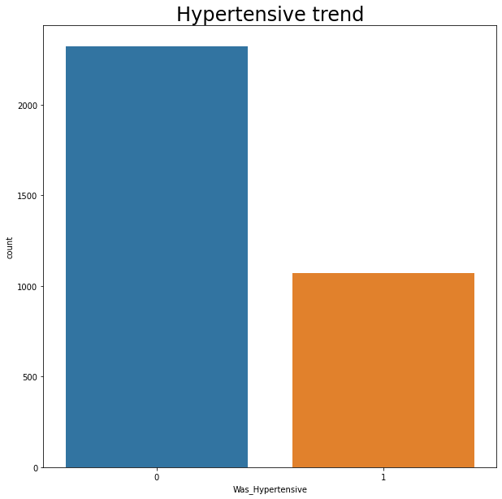
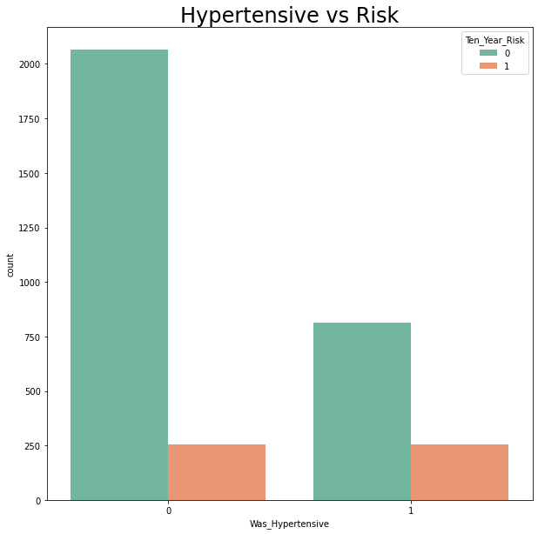
Risk With Respect To Hypertensive:

Slide 17
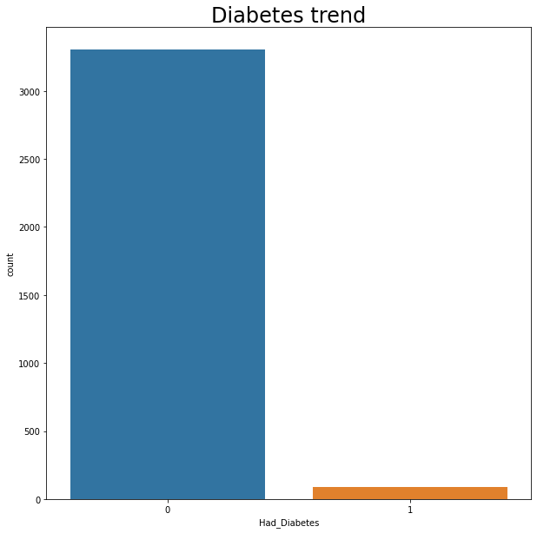
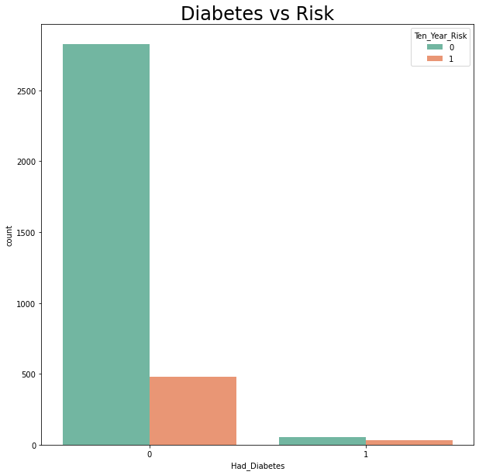
Risk With Respect To Diabetes:

Slide 18
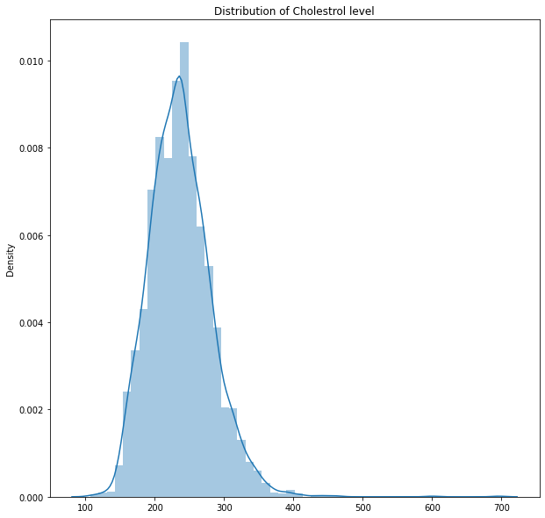
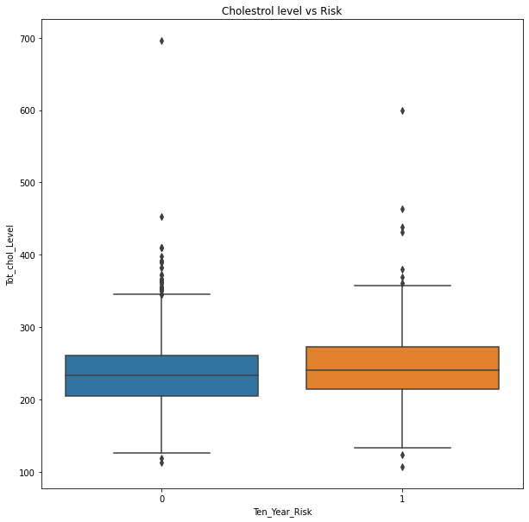
Risk With Respect To Cholesterol level:

Slide 19
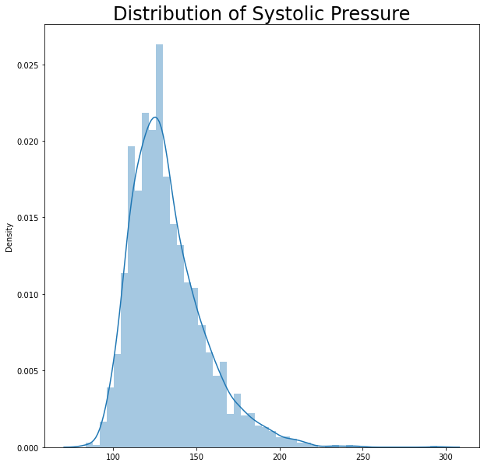
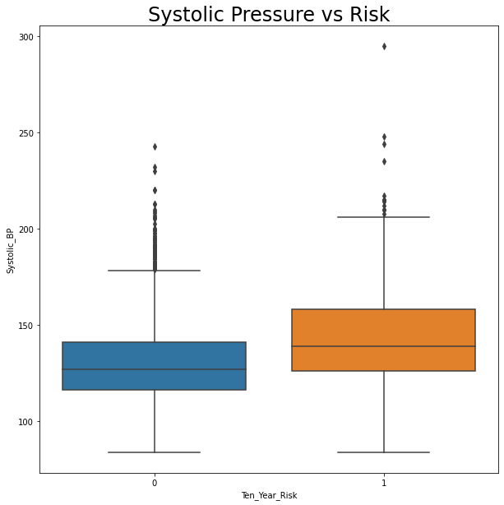
Risk With Respect To Systolic Pressure:

Slide 20
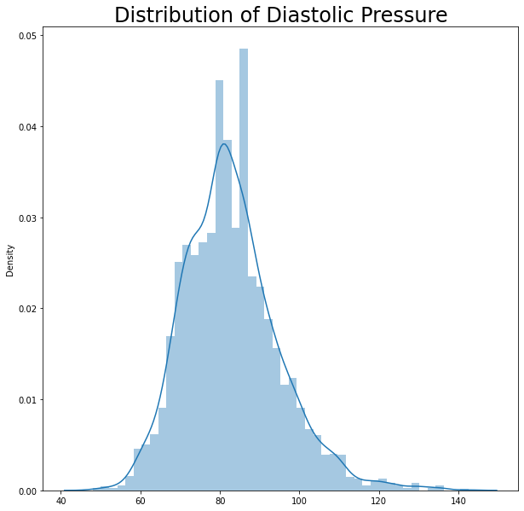
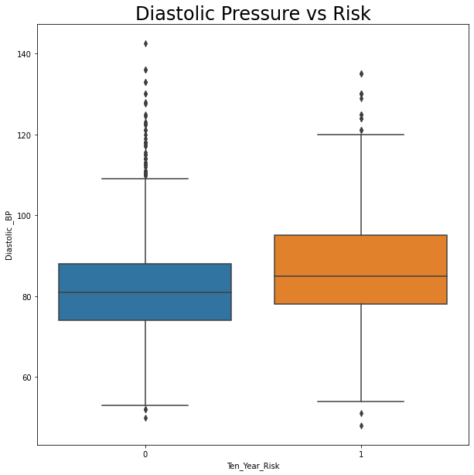
Risk With Respect To Diastolic Pressure:

Slide 21
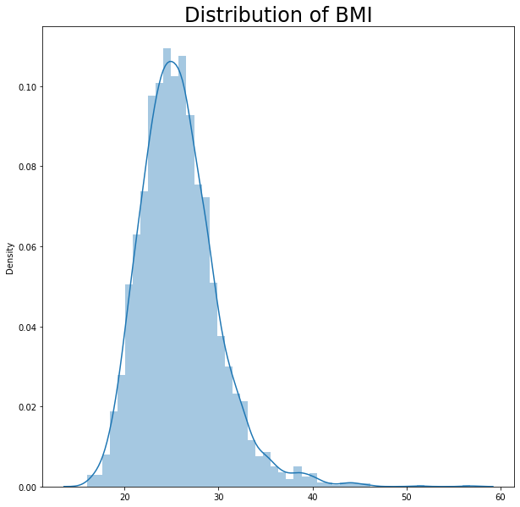
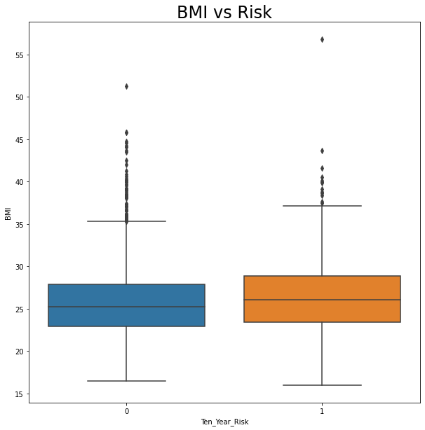
Risk With Respect To BMI:

Slide 22
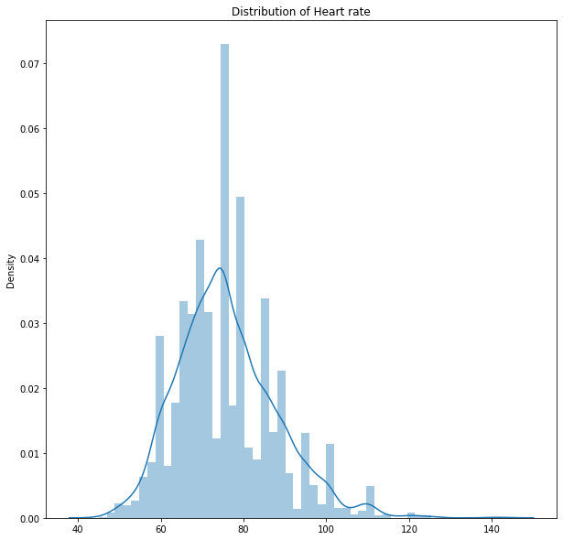
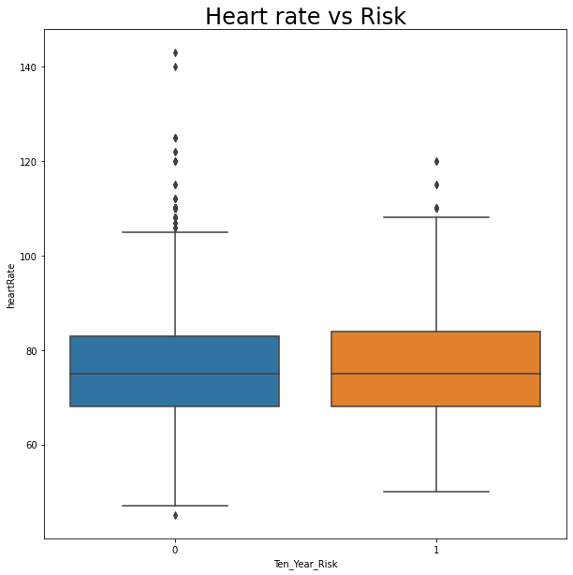
Risk With Respect To Heart Rate:

Slide 23
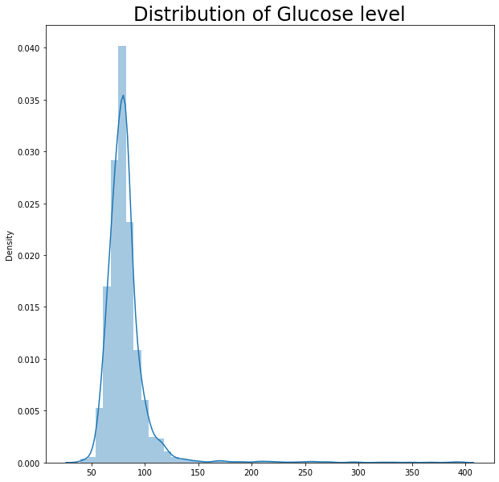
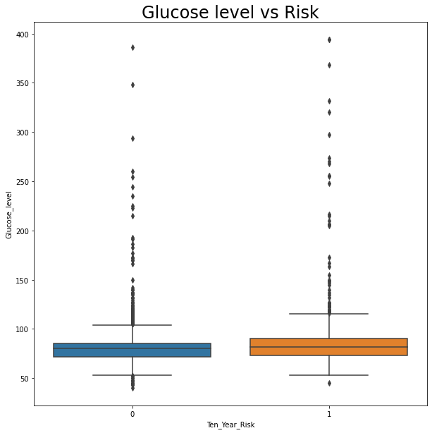
Risk With Respect To Glucose Level:

Slide 24
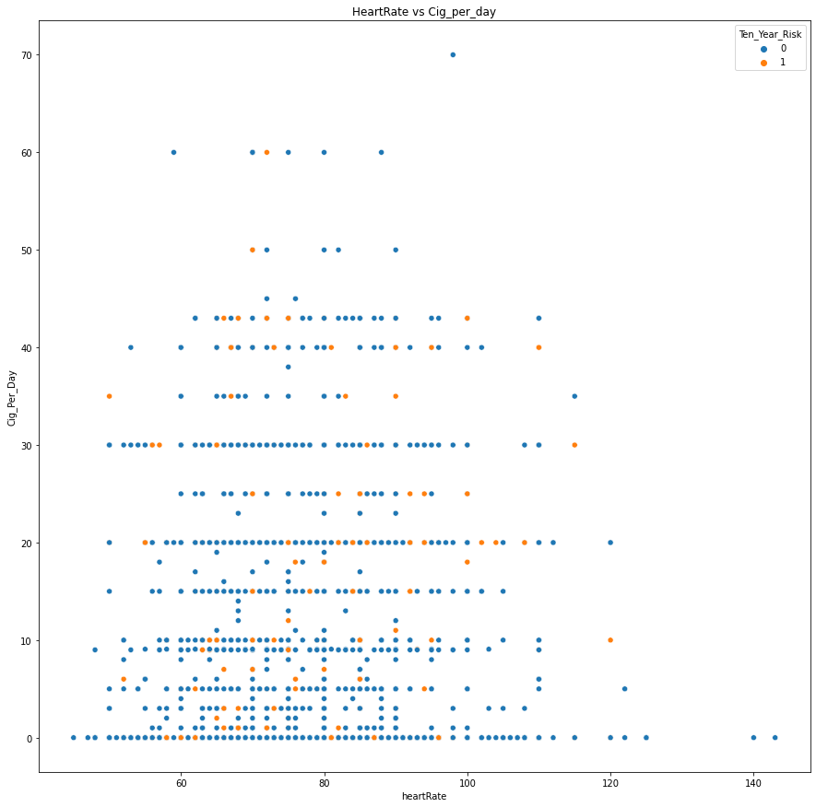
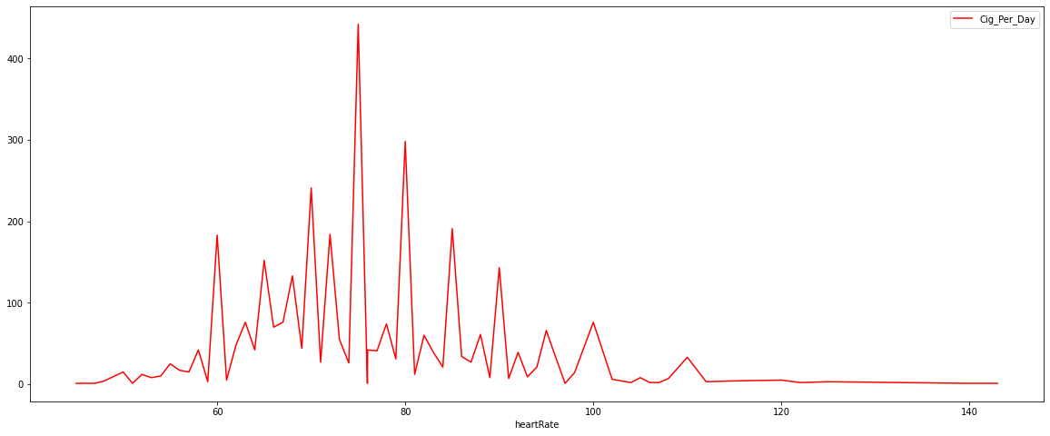
Heart Rate With Respect To Cigarettes Per Day:

Slide 25
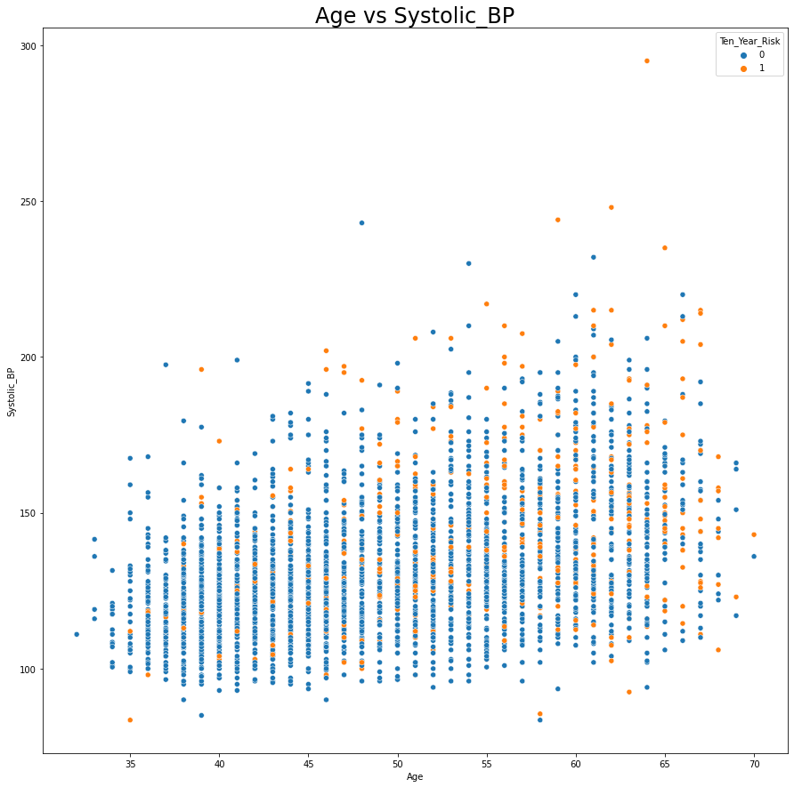
Systolic BP With Respect To Age:

Slide 26
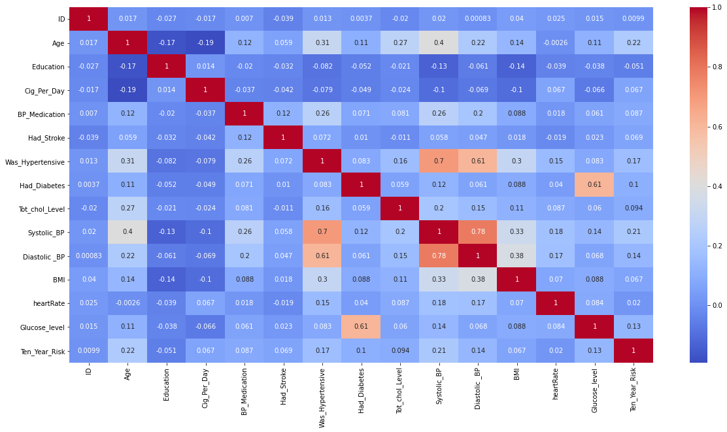
Correlation Matrix:

Slide 27
Data Preprocessing:
Data After Converting to Numerical :
Rows: 3390
Columns: 18
Which columns we have converted ?
Smoking
Gender

Slide 28
Models Used:
Logistic Regression
Support Vector Machine (SVM)
SVM with Linear Kernel
SVM with Polynomial Kernel
SVM with Gaussian Radial Base Kernel
Neural Networks
Random Forest Classifier
XGBoost

Slide 29
Model Validation and Selection:
Observation 1:
At first I’ve tried Logistic Regression but scores were not that satisfying.
Observation 2:
Then I’ve tried using Support Vector Machine, i got good scores as compared to logistic regression. Then I used SVM with Kernel Tricks I have used Linear kernel, Polynomial Kernel and Gaussian Radial Base Kernel I got good scores with polynomial kernel and radial base kernel.
Observation 3:
Then I’ve used Neural networks with one hidden layer but we did not got good scores.
Observation 4:
And lastly I’ve used Ensemble Learning models like Random Forest Classifier and XGBoost Classifier and both algorithms performed really well as compared to other models and with XGBoost I got the best Scores, so my optimal model is XGBoost Classifier.

Slide 30
Model Validation and Selection:
As XGBoost had performed really well so the best hyperparameters we got are:
'colsample_bytree': 0.7
'learning_rate': 0.03
'max_depth': 7
'min_child_weight': 4
'n_estimators': 500
'nthread': 4
'objective': 'reg:linear'
'silent': 1
'subsample': 0.7

Slide 31
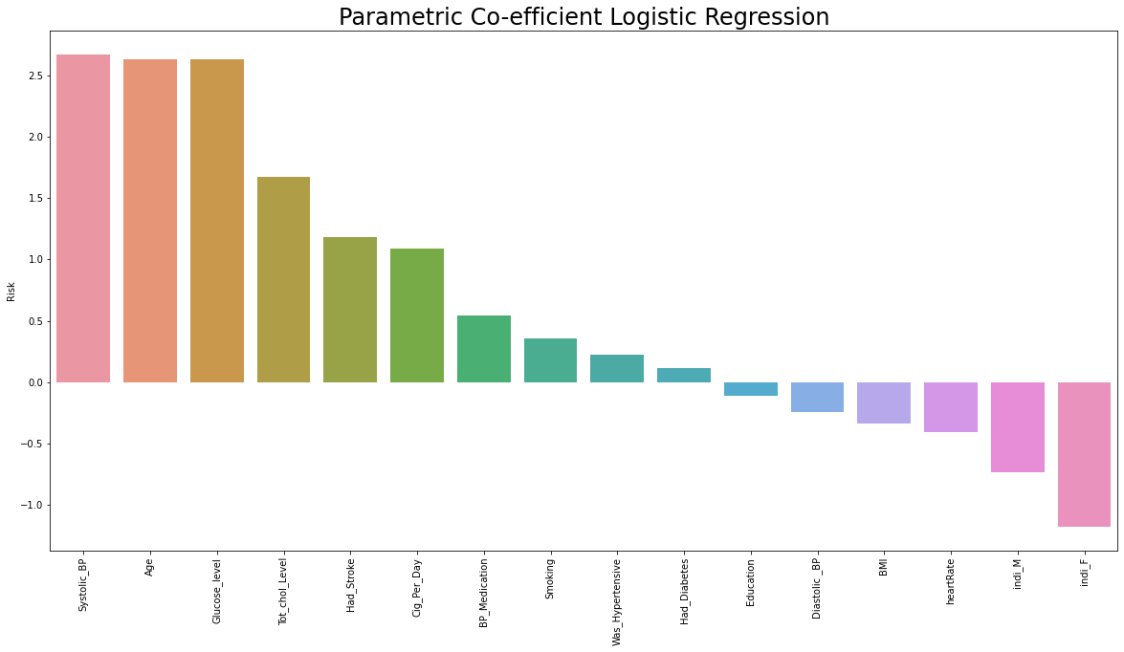
Feature Importance for Logistic Regression:

Slide 32
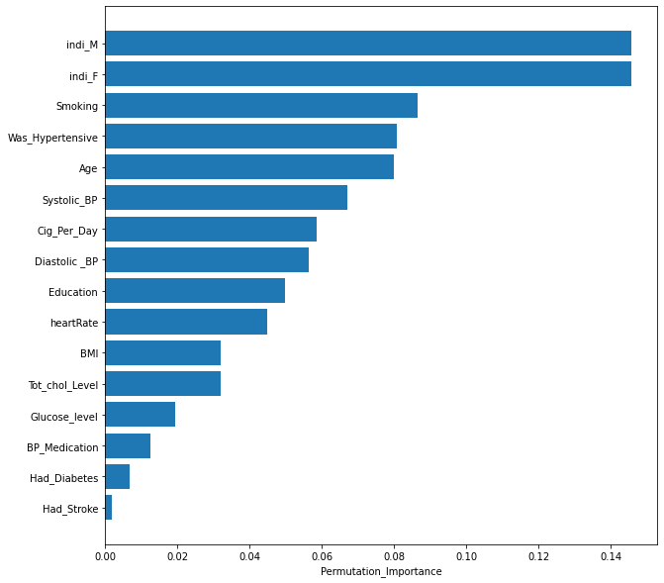
Feature Importance for Support Vector Machine:

Slide 33
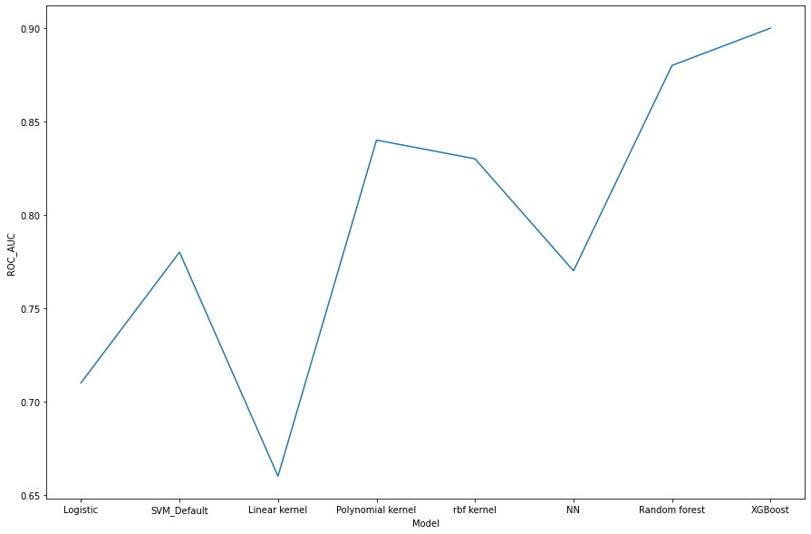
ROC AUC Comparison:

Slide 34



Challenges:
Execution takes time.
As there were many null values present in data set it took time to clean the dataset.
Difficulty in selecting the appropriate graph for trend.

Slide 35

Conclusion:
There are 15.1 % people in our dataset are is risk for cardiovascular disease and 84.9 % people are safe (ten year risk).
There is more risk of cardiovascular disease in patients of age between 51 to 63.
The count of male and female are same in risk which is around 200, though females are more than males in our dataset.
Around 250 smokers are in risk and around 210 non-smokers are is risk for cardiovascular disease.
We can’t evidentially state smoking will lead to heart disease, as we seen from count plot there is no huge difference between these to commune and also our extreme smoker who smokes 70 cigarettes per day is not having ten year risk.
There are very few people who are done with BP medication which are around 200 but many people have not taken any BP medication and they are around 3200. We cannot say that after taking medication person is safe.
Around 500 patients who did not had stroke yet and are at risk and around 2800 patients are safe.
around 250 people with hypertensive are in risk and around 255 people with no hypertensive are at risk.
Here we can see people who did not had diabetes are more and around 500 people who did not had diabetes are at risk.And there are very few people who had diabetes are at risk.
most of the people who are not in risk their Cholesterol level lies between 210 to 280 and people who are in risk their cholestrol level lies between 215 to 285 there in not huge difference it is quite normal.
most people who are not in risk their systolic BP lies between 110 to 140 and people who are at risk their systolic BP lies between 125 to 160. we can say people with high systolic BP are at risk.
most people who are not in risk their diastolic BP lies between 75 to 85 and people who are at risk their diastolic BP lies between 89 to 90. we can say there is a slight increase in diastolic BP of people who are in risk.
most people who are not in risk their BMI lies between 22 to 28 and people who are at risk their BMI lies between 23 to 29 approx. WE cannot see any difference BMI is approx. same of risky and not risky people.

Slide 36
Conclusion:
most people who are not in risk their heart rate lies between 68 to 83 and people who are at risk their heart rate lies between 68 to 84. which is same for risky and not risky people.
there is not that difference between the glucose level of risky and non risky patients. glucose level lies between 70 to 80 for both risky and non risky patients.
most people smoke cigarettes between 1 to 10 approx. and there heart rate lies between 60 to 100.
age of people lies between 32 to 70 and most of the people's systolic BP lies between 90 to 200.
With logistic regression we got the accuracy score of 0.68 on train data and 0.66 on test data.
With Support vector machine we got the train accuracy score of 0.79 and test accuracy score of 0.78.
With support vector linear kernel we got the train accuracy score of 0.67 and test accuracy score of 0.67.
With support vector polynomial kernel we got the train accuracy score of 0.95 and test accuracy score of 0.84.
With Gaussian radial base kernel we got the train accuracy score of 0.97 and test accuracy score of 0.83.
With Neural Networks we got the Train Accuracy score of 0.81 and test accuracy score of 0.77.
With Random forest classifier we got the train accuracy of 0.97 and test accuracy of 0.89.
With XGBoost classifier we got the train accuracy score of 0.99 and test accuracy of 0.90.

Slide 37


